Slide 1

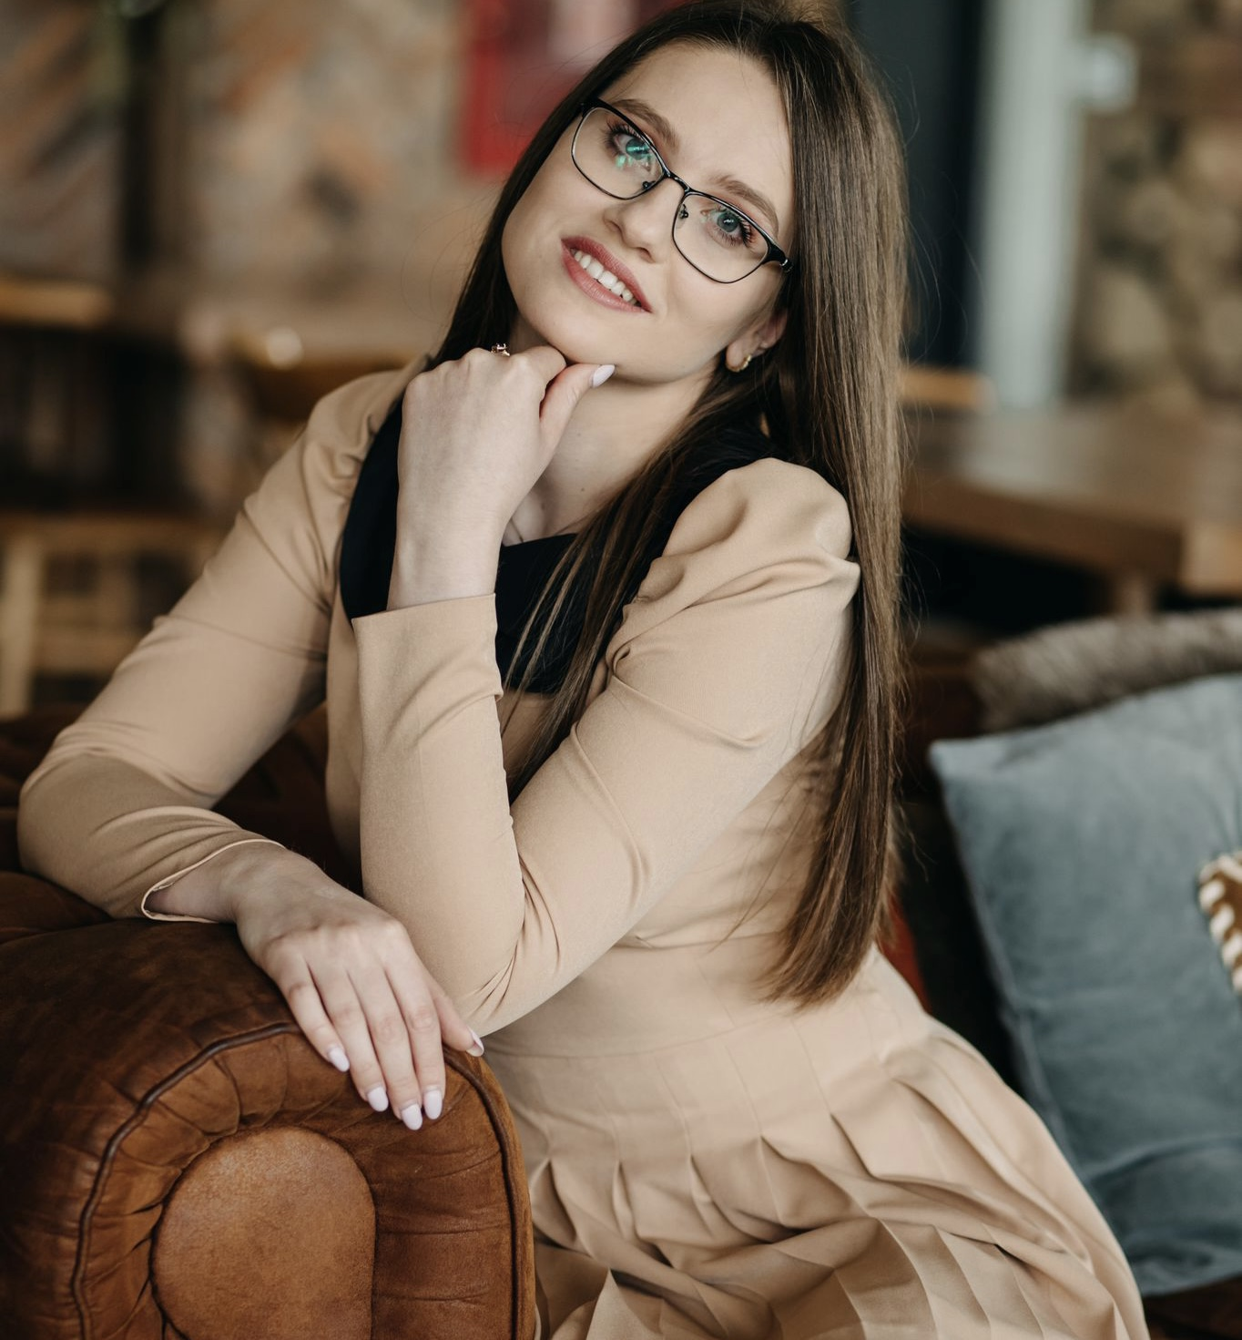
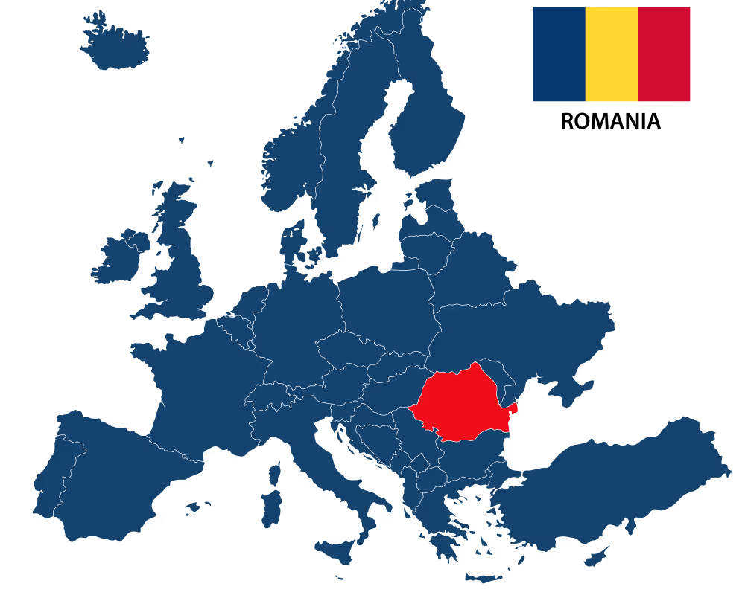

University: Transilvania University of Braşov, Faculty of Food and Tourism / University of agricultural sciences and veterinary medicine Bucharest, Faculty of Biotechnology
Study program: Biotechnology
Year of study: 3rd year of PhD
City: Braşov, Bucharest, Romania
Motto for life: Nothing is impossible for the one who believes.
Hobbies: reading, sports, travelling, spending time with friends and family.
Your expectations from the summer school:
My focus is on learning more about sustainable food systems, engaging in dialogue, and applying practical solutions to promote sustainability in research, education, and everyday practices.

